Slide 1

Numeric variables
Natalia Levshina © 2018
Tallinn University
March 6 -10 2018

Slide 2
Outline
One variable:
Descriptive statistics (mean, median, etc.)
Visualization (histograms, box plots, density plots)
Two variables:
Visualization (scatter plots)
Correlation analysis

Slide 3
Data frame ldt
> head(ldt) # returns the first 6 rows
Length Freq Mean_RT
marveled 8 131 819.19
persuaders 10 82 977.63
midmost 7 0 908.22
crutch 6 592 766.30
resuspension 12 2 1125.42
efflorescent 12 9 948.33

Slide 4
Data frame structure
> str(ldt) # displays the structure
'data.frame': 100 obs. of 3 variables:
$ Length : int 8 10 7 6 12 12 3 11 11 5 ...
$ Freq : int 131 82 0 592 2 9 14013 15 48 290 ...
$ Mean_RT: num 819 978 908 766 1125 ...

Slide 5
Attach a data frame
> head(ldt$Length)
[1] 8 10 7 6 12 12
> head(Length)
Error in head(Length) : object 'Length' not found
> attach(ldt)
> head(Length) #now you can access all variables directly
[1] 8 10 7 6 12 12

Slide 6
Mean, median and mode
> mean(Length)
[1] 8.23
> median(Length)
[1] 8
> table(Length) #shows how many times every value occurs; the most popular value is the mode
3 4 5 6 7 8 9 10 11 12 13 14 15
2 5 7 13 12 16 11 16 11 3 1 2 1

Slide 7
Understanding the median

Slide 8
Ocean’s 11: the median

Slide 9
Ocean’s 12

Slide 10
Ocean’s 12: the median

Slide 11
Mean vs. median
In some situations the median gives a better idea of the most typical value than the mean. The problem with the latter is that it is easily influenced by outliers, i.e. scores with unusually high or low values.
For example, if twenty employees in a company have net salaries of €2000 a month, and the CEO’s salary is €50000, the mean salary will be €4286, and the median will be €2000. The median gives a more realistic idea of the salaries in the company than the mean because the CEO’s salary is exceptional.

Slide 12
Exercise
Find the mean and the median of the reaction times in ldt.

Slide 13
A very useful function summary()
> summary(Mean_RT)
Min. 1st Qu. Median Mean 3rd Qu. Max.
564.2 713.1 784.9 808.3 905.2 1458.8

Slide 14
Measures of dispersion
> range(Length) # the minimum and the maximum
[1] 3 15
> var(Length) #variance = sum of squared deviations [1] 6.259697 from the mean, divided by the number of observations - 1
> sd(Length) # standard deviation = the squared root [1] 2.501939 of variance

Slide 15
Why care about the dispersion?
Consider two countries with a similar average income per capita. In one country the variance and standard deviation are relatively small because the finances are distributed fairly, whereas in the other they are very large because of several billionaires and many extremely poor people. Although the means are identical, life in the two countries will differ dramatically.

Slide 16
Statisticians make jokes, too ☺
If your head is in the oven, and your feet are in the fridge, on average you're quite comfortable.
Image from moneymarketing.co.uk

Slide 17
Boxplot
> boxplot(Mean_RT)
A bit more sophisticated:
> boxplot(Mean_RT, main = "Mean reaction times", ylab = "reaction time in ms")

Slide 18
Box-and-whisker plot
Outliers (more that 1.5 times IQR)
Upper whisker: max.1.5 times IQR from the upper hinge
Upper hinge: 3rd quartile, or 75%
Median (or the 2nd quartile, or 50%)
Lower hinge: the 1st quartile, or first 25%
Lower whisker: max. 1.5 times IQR from the lower hinge

Slide 19
Boxplot stats
> boxplot.stats(Mean_RT)
$stats # l. whisker, l. notch, median, u. notch, u. whisker
[1] 564.180 712.285 784.940 905.930 1125.420
$n #number of observations
[1] 100
$conf # ignore for the time being
[1] 754.3441 815.5359
$out # outliers
[1] 1314.33 1216.81 1458.75

Slide 20
Histogram
> hist(Mean_RT, main = "Histogram of mean reaction times", xlab = "reaction times, ms")
A histogram shows the frequencies of different values aggregated in bins.

Slide 21
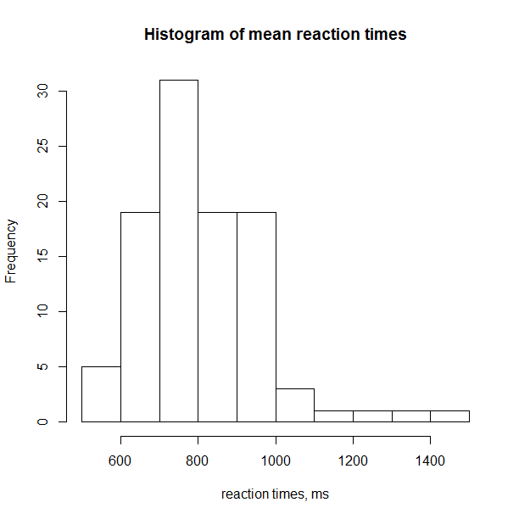

Slide 22
Outline
One variable:
Descriptive statistics (mean, median, etc.)
Visualization (histograms, box plots, density plots)
Two variables:
Visualization (scatter plots)
Correlation analysis

Slide 23
Word length and reaction times
Hypothesis: there is some correlation between word length and mean reaction times in a lexical decision task.
This is a non-directional alternative hypothesis.
Null hypothesis: no correlation.

Slide 24
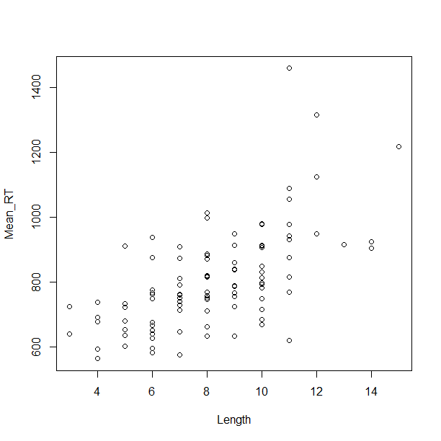
Scatter plot
> plot(Length, Mean_RT)

Slide 25
Correlation
A relationship between two numeric variables
Positive: as X increases, Y increases, too. E.g. the more beers you drink before a psycholinguistic experiment, the longer your reaction times will be.
Negative, or inverse: as X increases, Y decreases. E.g. the more frequent a word, the shorter it is (Zipf’s Law of Abbreviation).

Slide 26
Correlation coefficient
A statistic from -1 to 1 which shows the direction and strength of a correlation.
Negative correlation: from -1 to 0
Positive correlation: from 0 to 1
No correlation: 0

Slide 27
Perfect positive and negative correlations

Slide 28
Strong, weak and zero correlation

Slide 29
Exercise
Can you think of one example of a positive correlation, one example of a negative correlation, and one example of no correlation between two variables?

Slide 30
Types of relationships
Monotonic linear
Use Pearson’s r
Monotonic non-linear
Use Spearman’s rho or Kendall’s tau
Non-monotonic
A more sophisticated method is needed

Slide 34
Question: what kind of relationship?

Slide 35
Pearson’s r
> cor.test(Length, Mean_RT) #by default, Pearson and two-tailed
Pearson's product-moment correlation
data: Length and Mean_RT
t = 7.7158, df = 98, p-value = 1.019e-11
alternative hypothesis: true correlation is not equal to 0
95 percent confidence interval:
0.4757761 0.7237704
sample estimates:
cor
0.6147456

Slide 36
Beware of outliers
Can distort the results:

Slide 37
Interim conclusions
The null hypothesis of no association can be rejected.
The correlation is positive and significant.

Slide 38
Acquisition of grammar and lexicon
Bates and Goodman (1997) investigated the relationships between vocabulary size and grammatical development of young children during the period from 16 to 30 months.
Hypothesis: there is a positive correlation between vocabulary size and grammatical development.
Vocabulary size: the number of words learnt
Grammar: the total number of target constructions, from 0 to 37

Slide 39
Creating the data and a scatter plot
> lex <- c(47, 89, 131, 186, 245, 284, 362, 444, 553, 627)
> gram <- c(0, 2, 1, 3, 5, 9, 7, 16, 25, 34)
> plot(lex, gram)

Slide 40
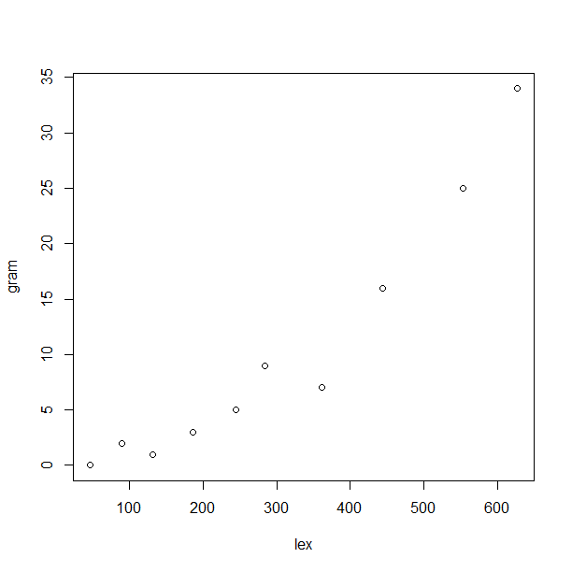

Slide 41
Spearman’s rho
> cor.test(lex, gram, method = "spearman“, alternative = "greater") #one-tailed
Spearman's rank correlation rho
data: lex and gram
S = 4, p-value < 2.2e-16
alternative hypothesis: true rho is greater than 0
sample estimates:
rho
0.9757576

Slide 42
Kendall’s tau
> cor.test(lex, gram, method = "kendall", alternative = "greater")
Kendall's rank correlation tau
data: lex and gram
T = 43, p-value = 1.488e-05
alternative hypothesis: true tau is greater than 0
sample estimates:
tau
0.9111111

Slide 43
Interim conclusion
The null hypothesis of no correlation can be safely rejected.
There is a significant positive and very strong correlation between vocabulary size and grammatical development.

Slide 44
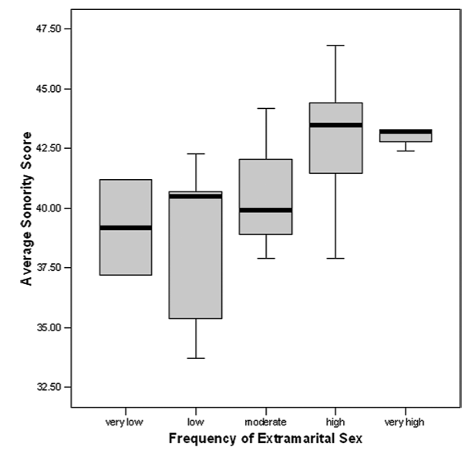
Correlation is NOT causation
From Ember & Ember 2007

Slide 45

Spurious correlations
http://www.tylervigen.com/spurious-correlations
Theory of the Stork: a positive correlation between the number of storks and that of newborns -> do storks bring babies?!

Slide 46
Exercise
Everett (2013) reported a positive correlation between elevation and the likelihood that a language contains ejective consonants:
“We suggest that ejective sounds might be facilitated at higher elevations due to the associated decrease in ambient air pressure, which reduces the physiological effort required for the compression of air in the pharyngeal cavity–a unique articulatory component of ejective sounds. In addition, we hypothesize that ejective sounds may help to mitigate rates of water vapor loss through exhaled air. ”
Can you think of another way of explaining this correlation?
http://journals.plos.org/plosone/article?id=10.1371/journal.pone.0065275

Slide 47
Detach the data frame
> detach(ldt)

